Slide 1

Satyajit Saha - 10505118
CRISP-DM on Google Play Store Apps

Slide 2
INTRODUCTION

Slide 3
What is CRISP-DM Methodology ?
CRISP-DM stands for cross industry process for data mining.
It provides a structural approach of planning a data-mining project.
It is robust and powerful methodology.

Slide 4
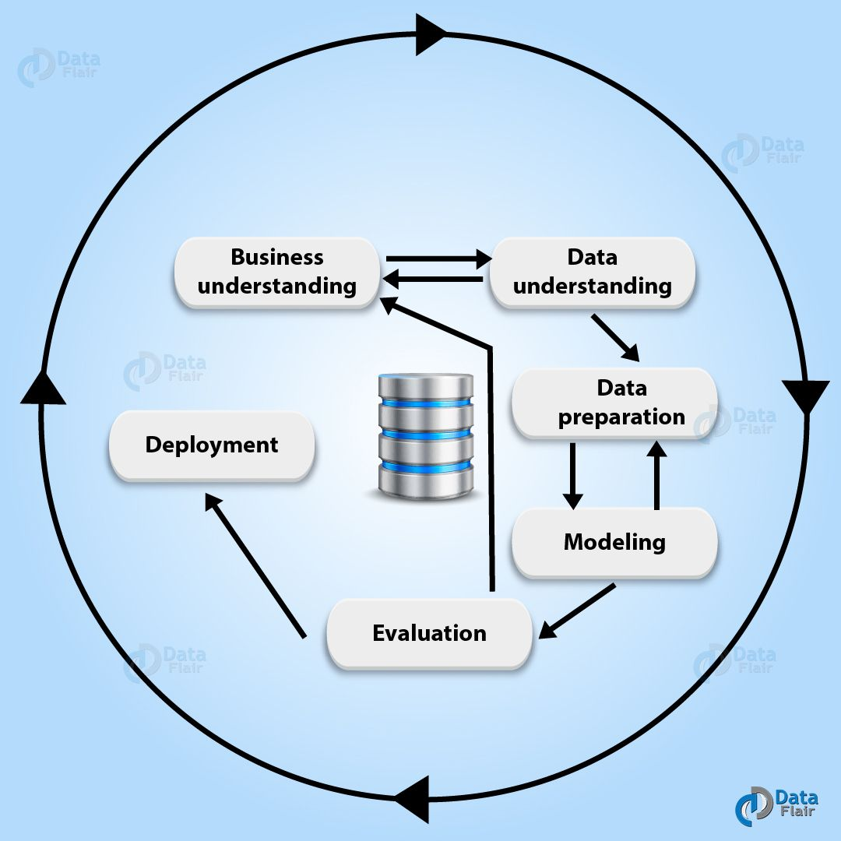
Process Cycle
Six phases in CRISP DM:
Business Understanding
Data Understanding
Data Preparation
Modelling
Evaluation
Deployment

Slide 5
BUSINESS UNDERSTANDING

Slide 6
Description
First stage of CRISP-DM process is to understand what the customer wants to accomplish from a business perspective.
Customer often have completing objectives and constraints that must be properly balanced.
Neglecting this step can mean that a great deal of effort is put into producing the right answers to the wrong question.

Slide 7

Business Goal and Stake Holder
Aim: The primary objective is to overview the progress of the apps and its relation with ratings, genres, price and installation.
Stakeholder: The board of directors of Google Limited Liability Partnership.
Clients: Android user.

Slide 8
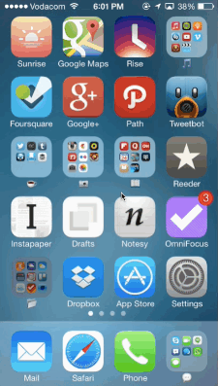


Available Resources
Dataset of apps Data Mining Tool Programming Tool

Slide 9
Project Task Period
Total timeline for the project is 3 weeks.
2 days set for business understanding.
5 days for data preparation as more time required for cleaning the dataset.
3 days each for data modelling ,evaluation and deployment.
Extra 5 days to be kept as buffer time to solve error.

Slide 10
DATA UNDERSTANDING

Slide 11
Description
Second phase of the CRISP-DM process model.
The data-understanding phase includes four tasks.
Gathering data
Describing data
Exploring data
Verifying data quality

Slide 12

Gathering Data
Google play dataset from Kaggle.
Gautham Prakash (2019). Google Play Store Apps. [online] Kaggle.com. Available at: https://www.kaggle.com/gauthamp10/google-playstore-apps [Accessed 13 July. 2019].

Slide 13
Describing Data
The dataset is in CSV format.
It have 2000 rows (examples) and 11columns (attributes) before data preparation.
Possess columns like Apps Name, Category, Size, Ratings, Price, Current Version and Last Updated

Slide 14
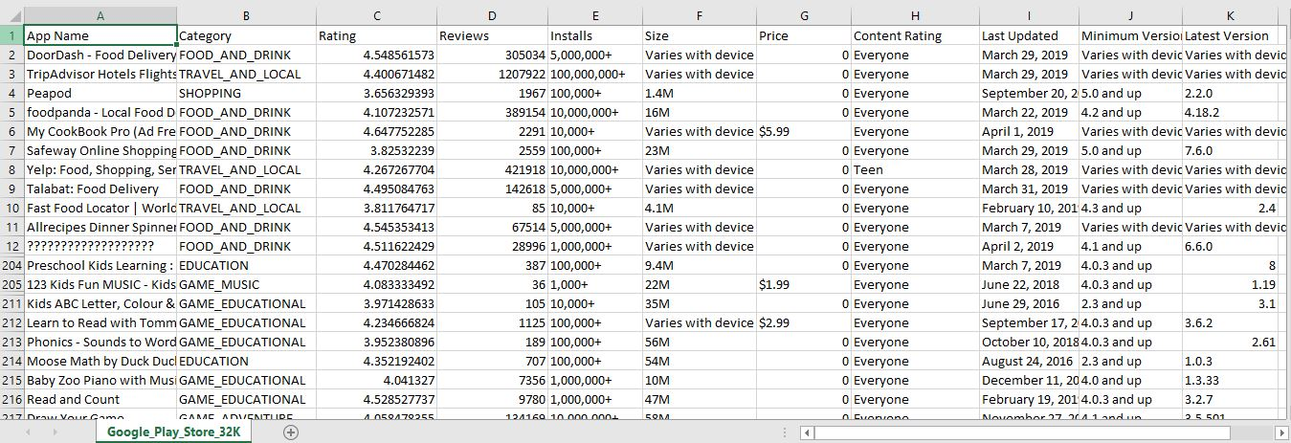
Exploring Dataset

Slide 15
Verifying Data Quality
The dataset is semi structured.
Possess missing values, NA values, blank values, special character like ?,@,&,# in some records.
Programming tool is required to prepare the dataset and transform into well structured form.

Slide 16
DATA PREPARATION

Slide 17
Description
This stage is to transform un-organized data into well-organized form.
Tedious and time consuming task
The following task is being process in this stage.
Cleaning of data
Construct data
Integrations and formation of data

Slide 18
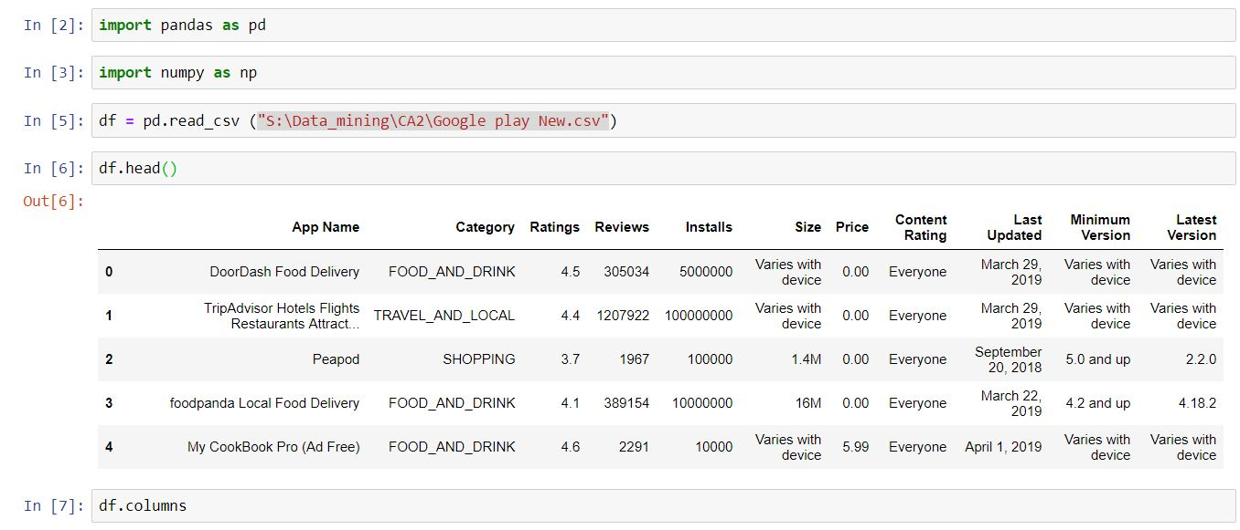
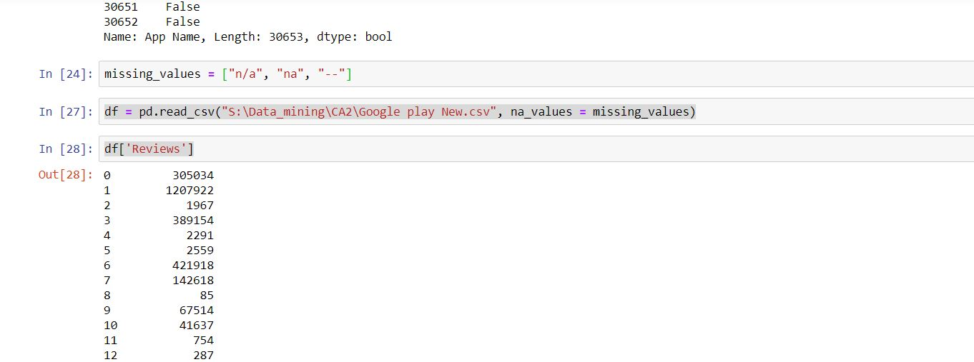
Cleaning of data
Python programming is used for cleaning the dataset.
Library: Pandas and NumPy is used.

Slide 19
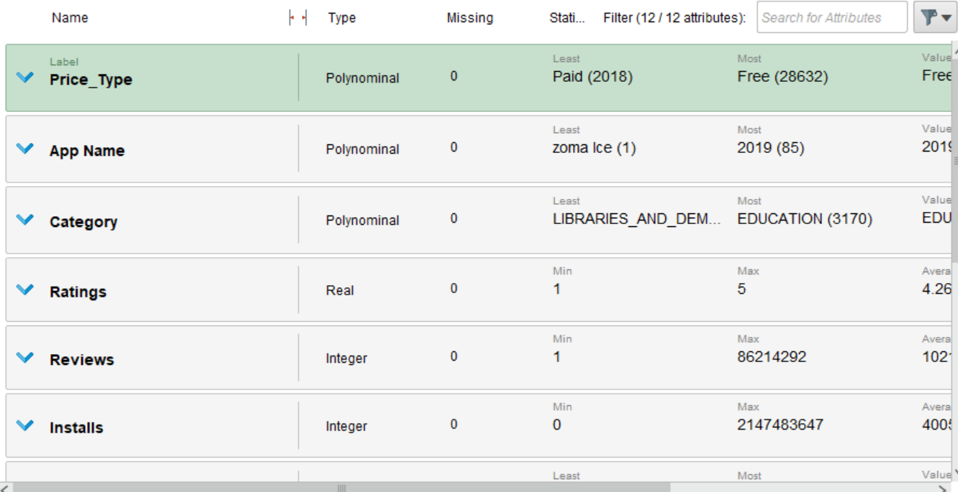
Construct Data
No missing values.
No missing attributes.
Removal of special character values.
Data in well organized.
Verified in RapidMiner.

Slide 20
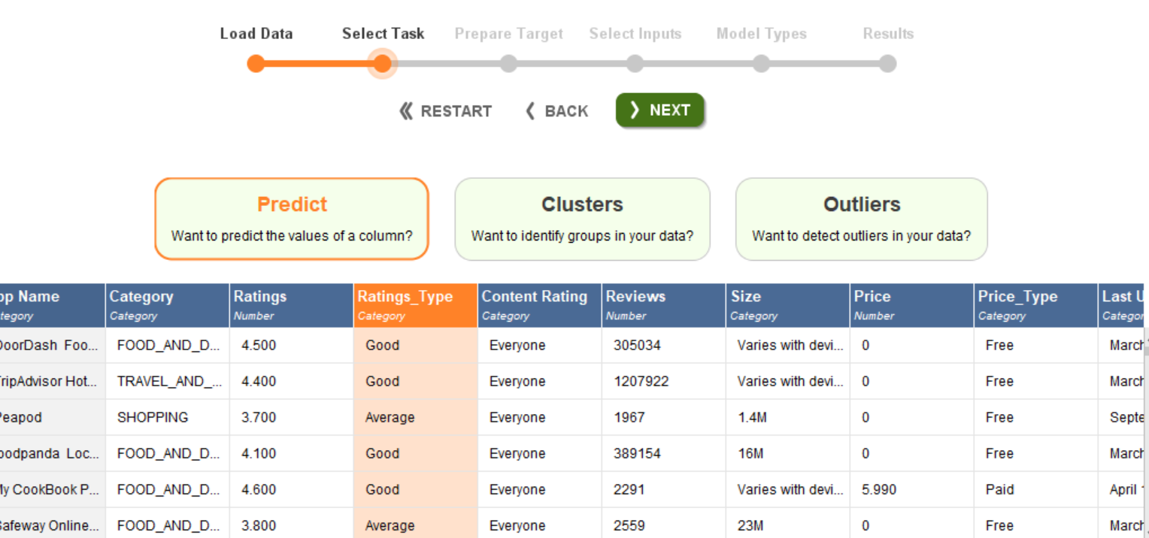
Integration and Formation of data
Data is apply for processing.
Selection of task: Prediction
Selection of target attribute: ‘Rating Type’.

Slide 21
MODELLING

Slide 22
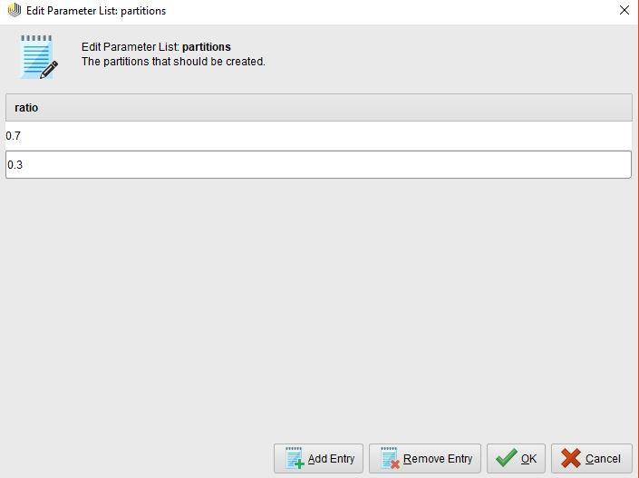
Description
Various modelling techniques is apply in this stage.
Split of data: 70:30
Supervised learning algorithm:
Random Forest
Gradient Boosted Tree
Decision Tree

Slide 23
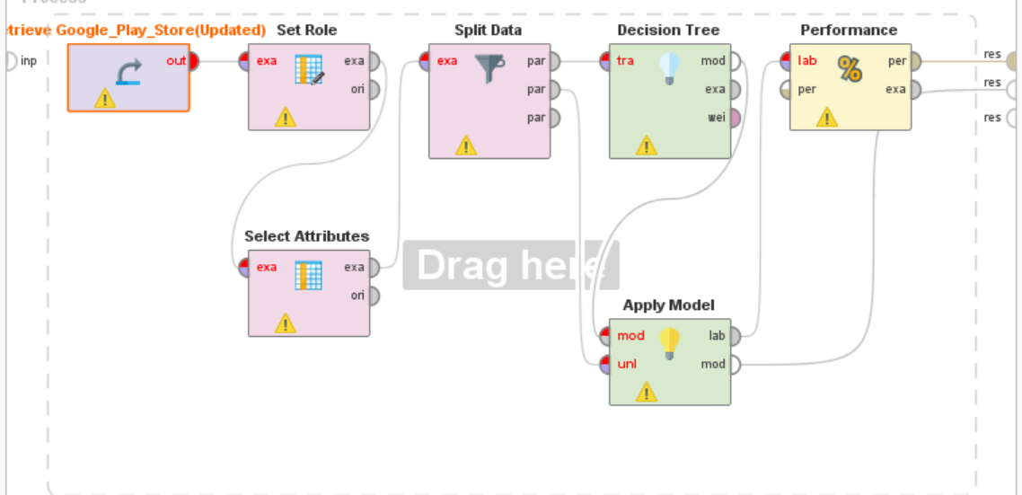
Build the Model
Decision Tree

Slide 24
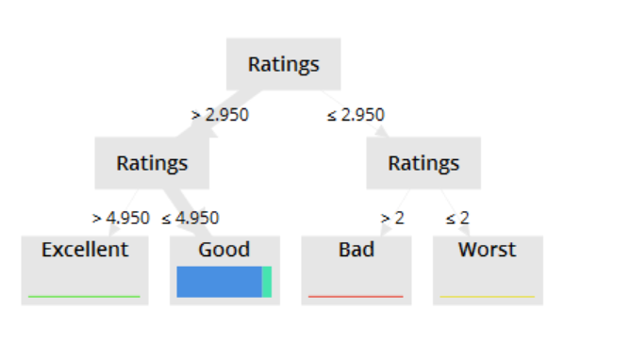
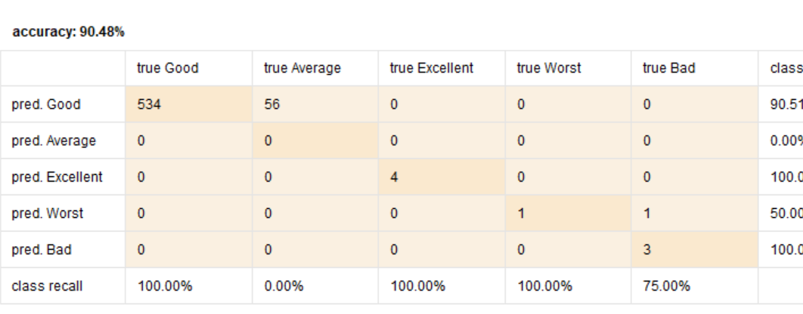
Output and Accuracy

Slide 25
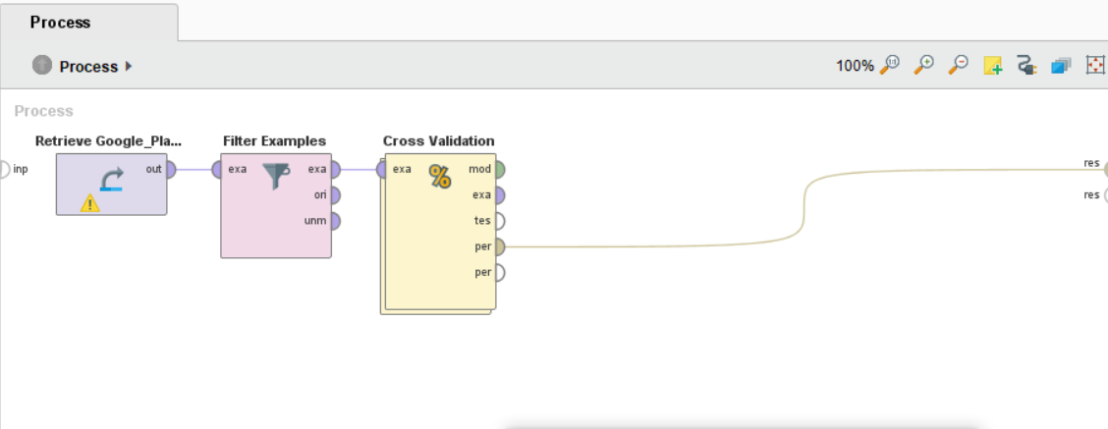
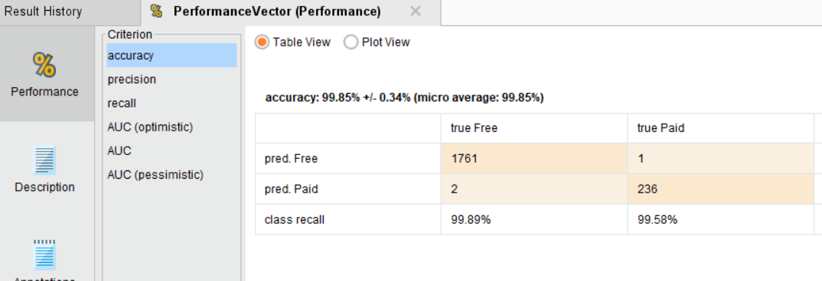
Cross Validation on Decision Tree
Accuracy -99.85 %

Slide 26
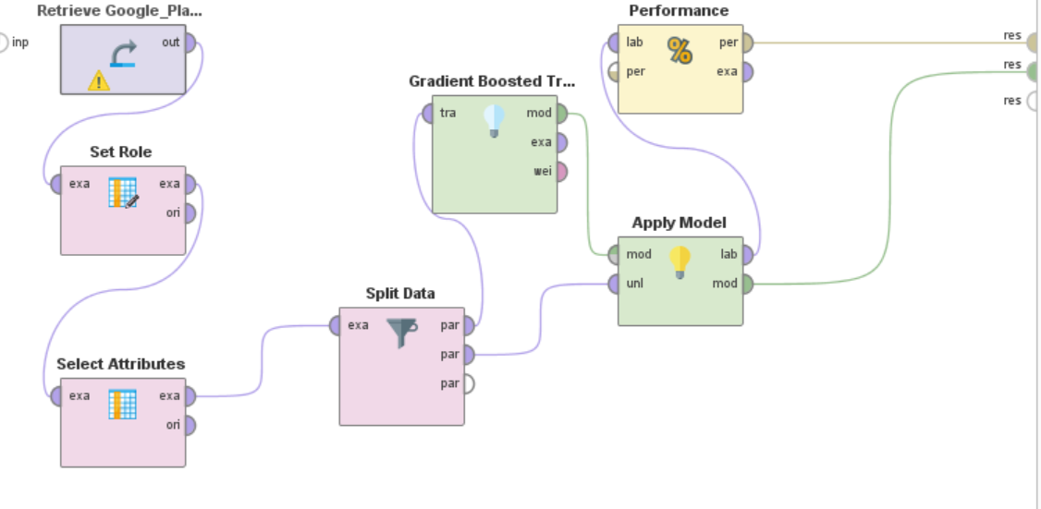
Gradient Boosted Tree

Slide 27
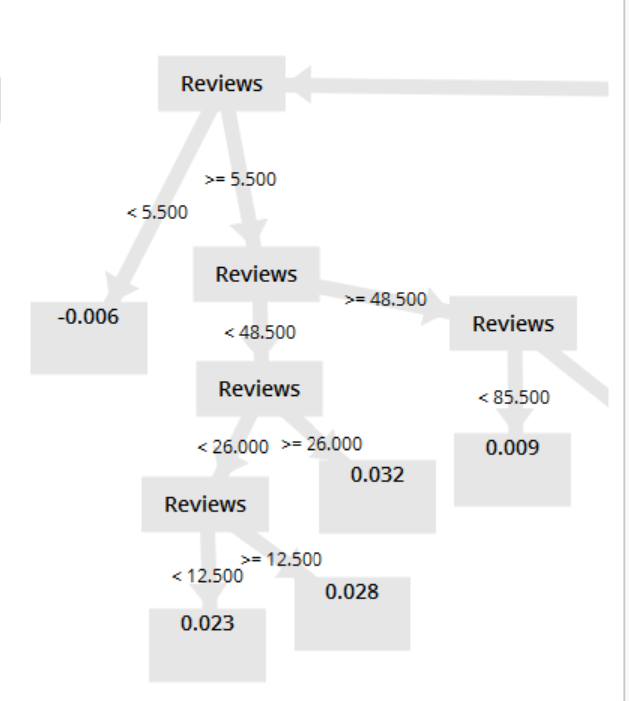
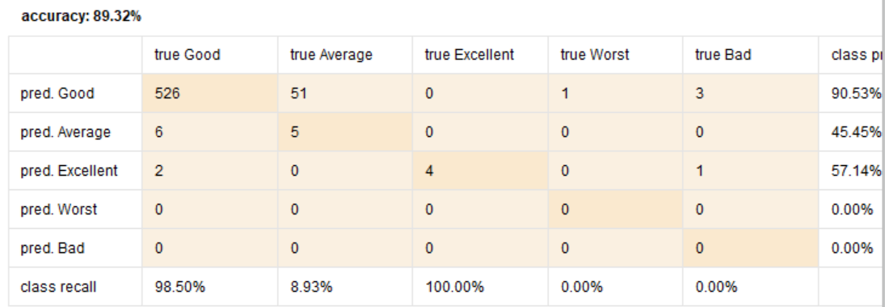
Output and Accuracy

Slide 28
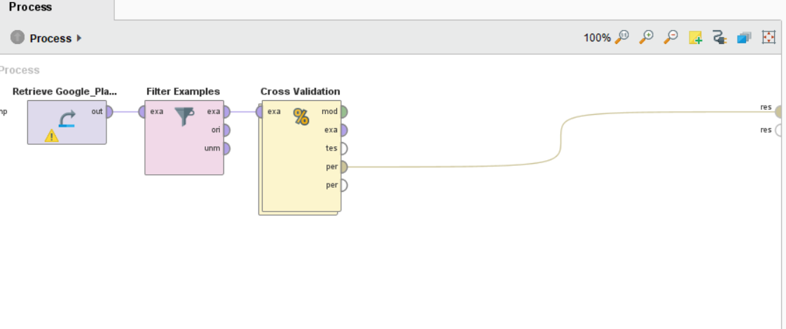
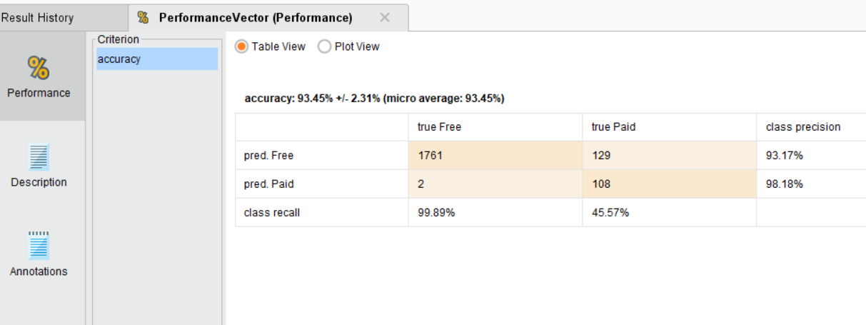
Cross Validation on Gradient Boosted Tree
Accuracy -93.45 %

Slide 29
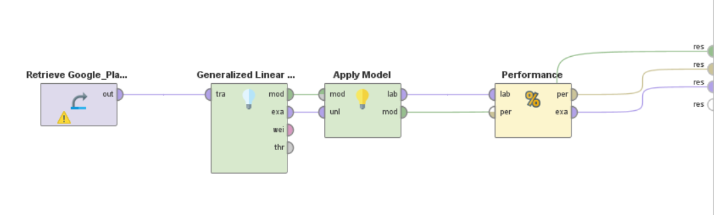
GLM Model

Slide 30
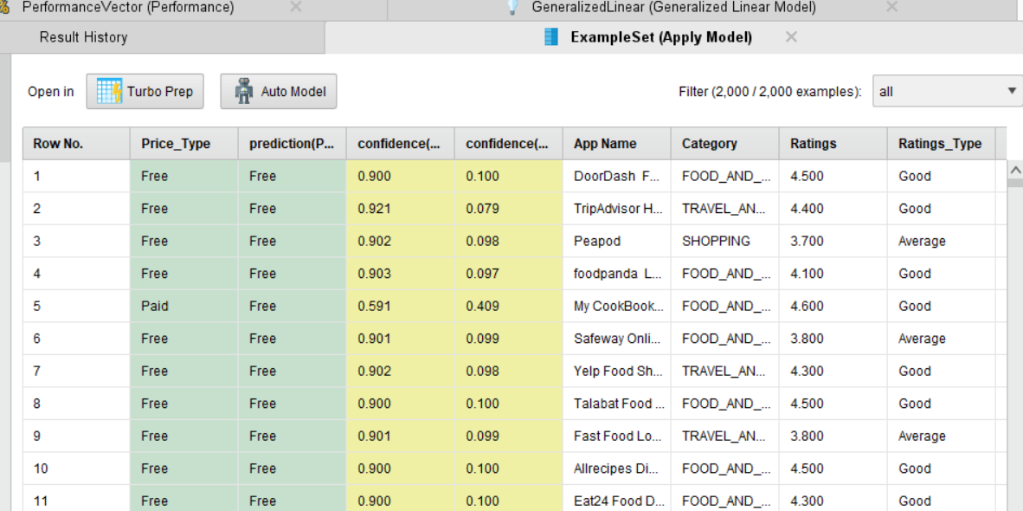
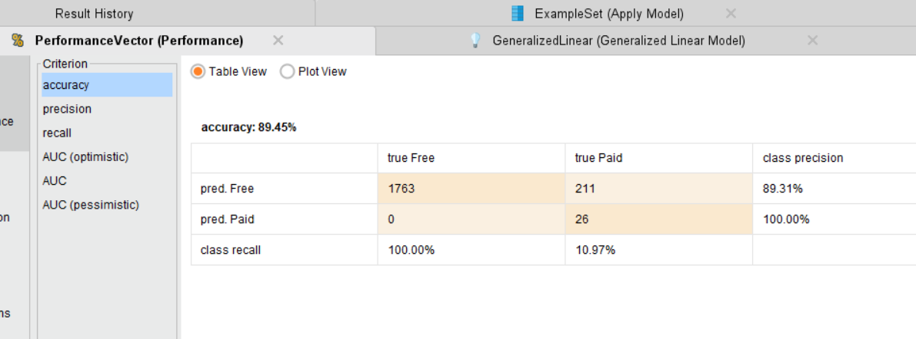
Output and Accuracy

Slide 31
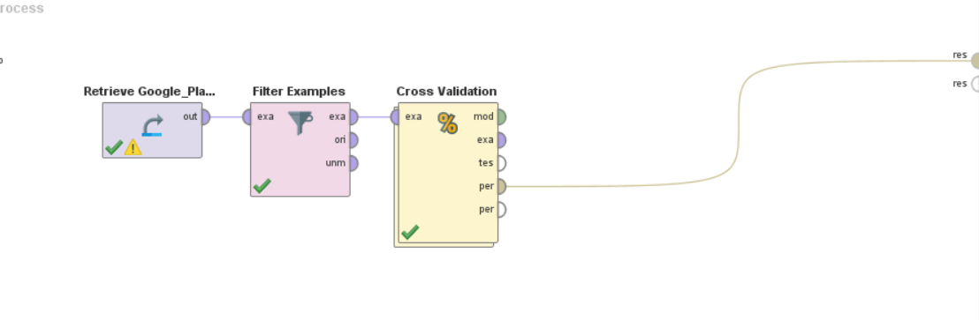
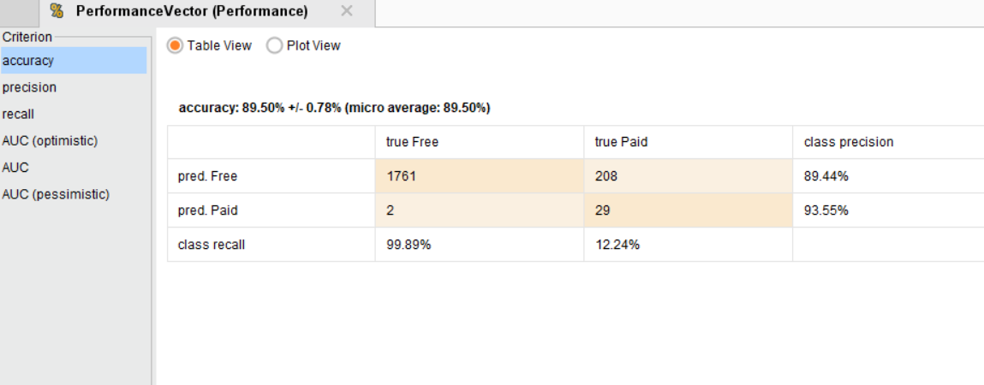
Cross Validation on GLM
Accuracy -89.50

Slide 32
EVALUATION

Slide 33
Description
In this following points are evaluated:
Construction of model
Review of process
Accuracy of result
The model meets the required business goals

Slide 34
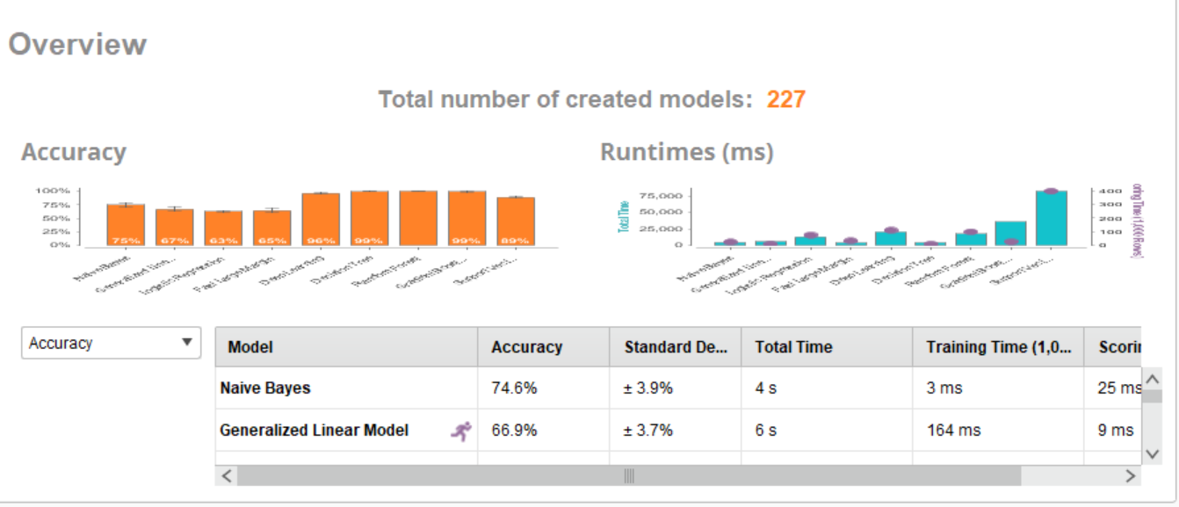
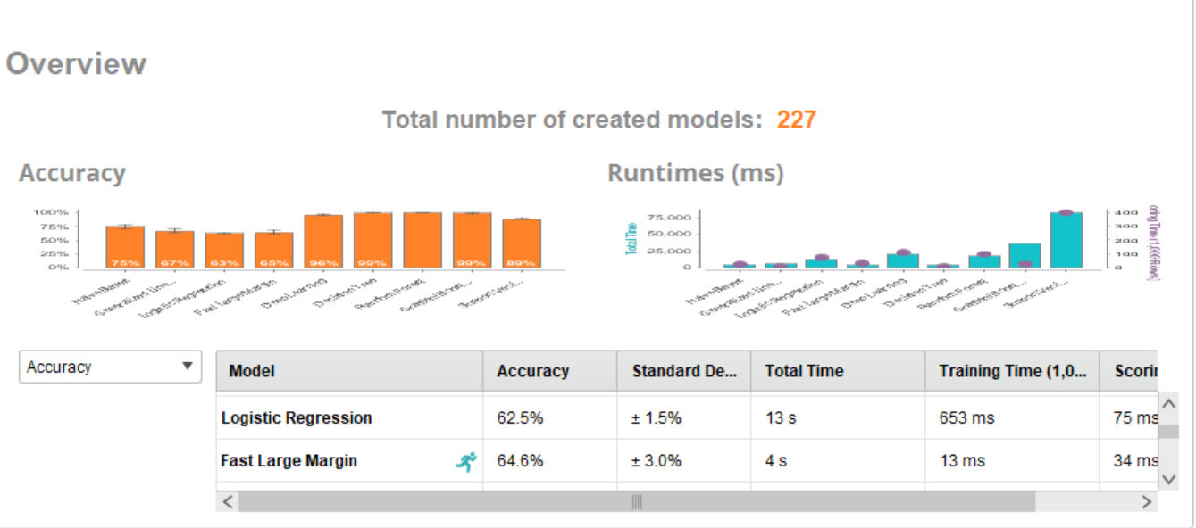
Why not other models ?

Slide 35
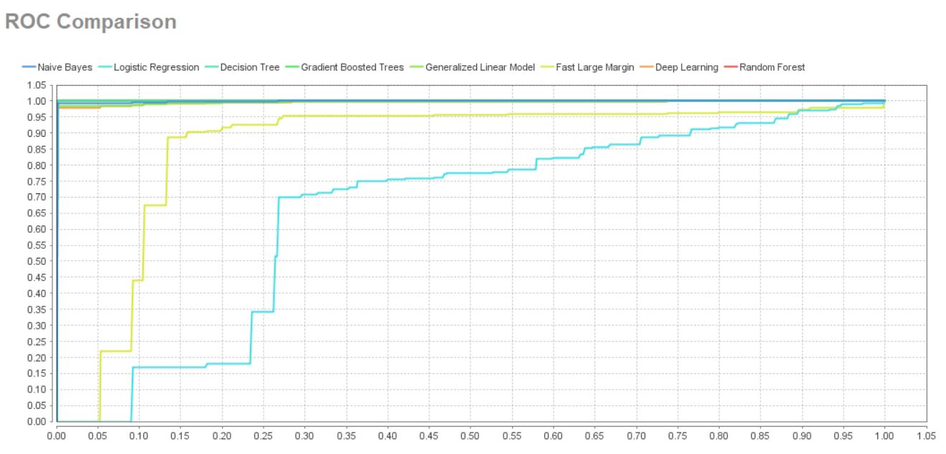
ROC Curve
Relative Operating Curve is used evaluating the quality and performance of model.

Slide 36
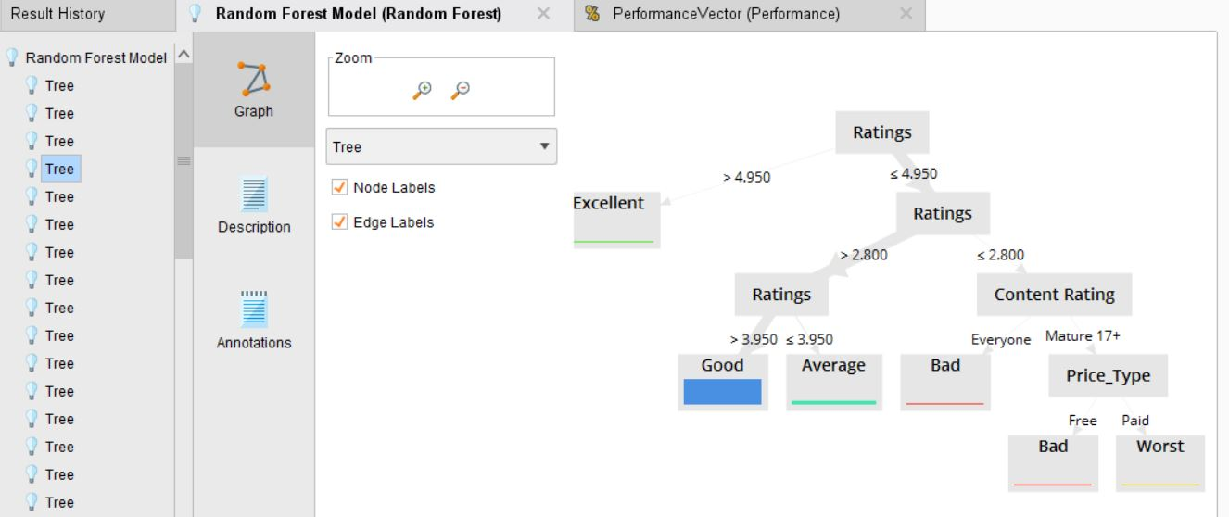
Meeting of Business Goal
Random Forest
Decision Tree
Accuracy: 99.83%
Accuracy: 90.48%

Slide 37
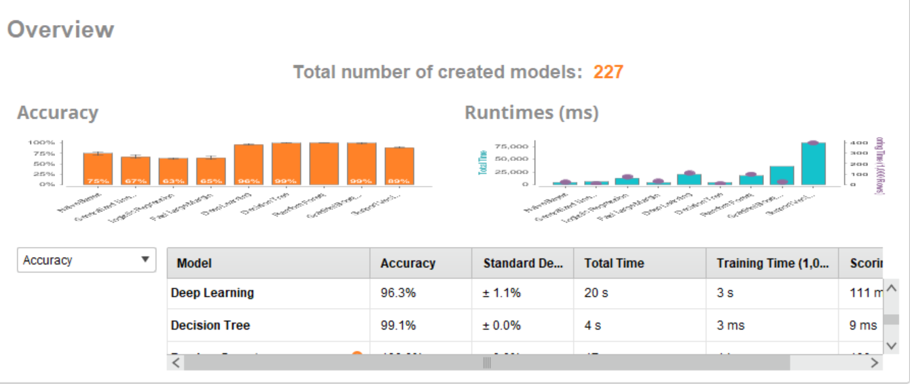
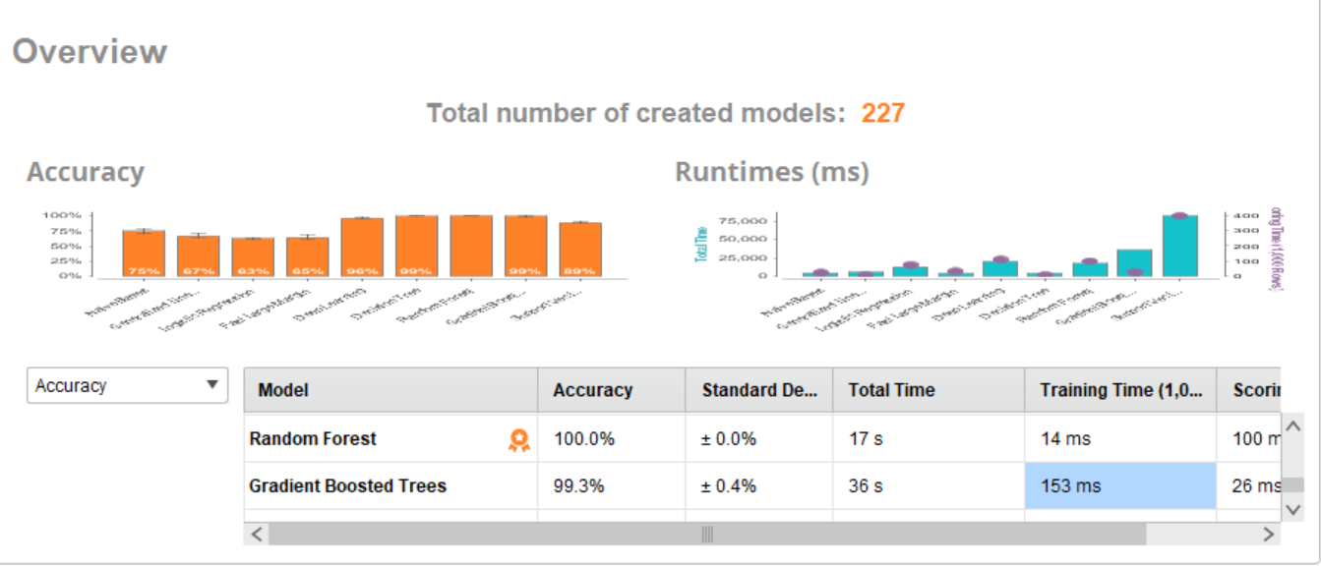
Review of Model
Difference in accuracy and error

Slide 38
Deployment

Slide 39
Description
The last phase of CRISP-DM. Essential points are
Plan deploy: Data Analyst should carefully deploy model.
Monitoring and Maintenance
Review of project
Final Report

Slide 40


Review of Project
Pros:
Data Cleaning Verify Successful
Model was not complex
Overall Accuracy is very good
Meet business goal
Cons:
Time Consuming in Data Preparation phase

Slide 41
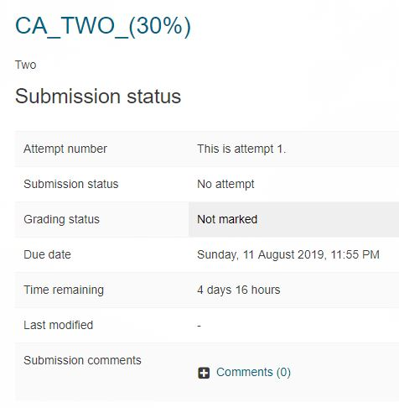
Final Report
Final report is yet to be prepare
Upload in CA Two in moodle.

Slide 42


Conclusion
Business of Google Apps is performing well as most of the apps have more than 4 star ratings.
Very few apps have below 3 star ratings.
A though competitor to apple app store.

Slide 43
References
[1] Gautham Prakash (2019). Google Play Store Apps. [online] Kaggle.com. Available at: https://www.kaggle.com/gauthamp10/google-playstore-apps [Accessed 13 July. 2019].
[2] Wikipedia Contributors (2019). Cross-industry standard process for data mining. [online] Wikipedia. Available at: https://en.wikipedia.org/wiki/Cross-industry_standard_process_for_data_mining [Accessed 5 Aug. 2019].
[3] Wikipedia Contributors (2019). Receiver operating characteristic. [online] Wikipedia. Available at: https://en.wikipedia.org/wiki/Receiver_operating_characteristic.

Slide 44
THANK YOU

